Slide 1
Fermet’s Little Theorem and Euler’s Totient function

Slide 2
Fermat's little theorem
The little theorem is often used in number theory in the testing of large primes .
If p is a prime which does not divide a( positive integer) , then a^{p-1}=1 (mod p)
If p is a prime that is not a factor of a, then when a is multiplied together p-1 times, and the result divided by p, we get a remainder of one.
For example, if we use a=7 and p=3, the rule says that 7² divided by 3 will have a remainder of one. In fact 49/3 does have a remainder of one.

Slide 3
Fermat's little theorem
We can test 3⁹⁰ using Fermat's Little Theorem without ever finding out what the actual value of 3⁹⁰ is, by using the patterns of remainders for powers of 3 divided by 91...
a=3 p = 7 3^6=729 remainder on division by 7 is 1
Since 3⁶ = 1 (mod 91) then any power of 3⁶ will also be =1 (mod 91), and 3⁹⁰= (3⁶)¹⁵.

Slide 4
Solve
Find 3³¹ mod 7.
Find 2³⁵ mod 7.
Find 128¹²⁹ mod 17.
The number 2¹⁰⁰⁰ is divided by 13. What is the remainder?
Find 29²⁵ mod 11.
Find 2²⁰ + 3³⁰ + 4⁴⁰ + 5⁵⁰ + 6⁶⁰ mod 7.

Slide 5
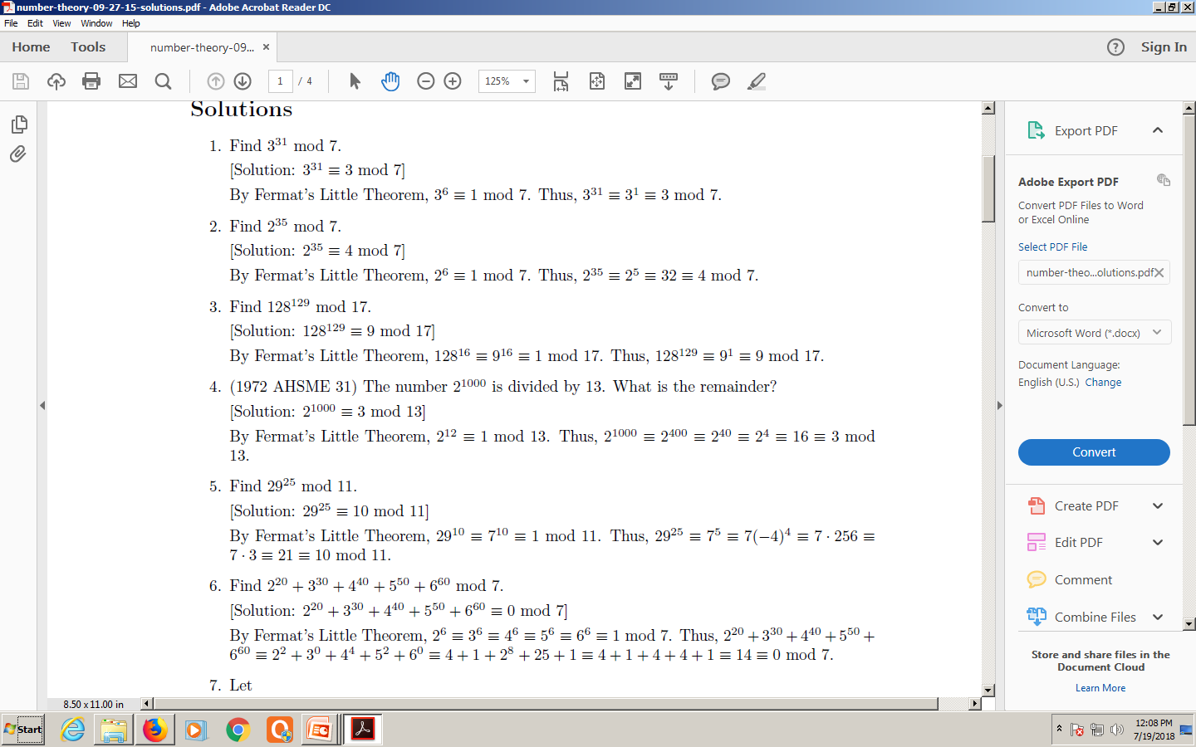

Slide 7
Euler's totient function
In number theory, Euler's totient function counts the positive integers up to a given integer n that are relatively prime to n.
It is written using the Greek letter phi as φ(n) or ϕ(n), and may also be called Euler's phi function.
It can be defined more formally as the number of integers k in the range 1 ≤ k ≤ n for which the greatest common divisor gcd(n, k) is equal to 1
The integers k of this form are sometimes referred to as totatives of n

Slide 8
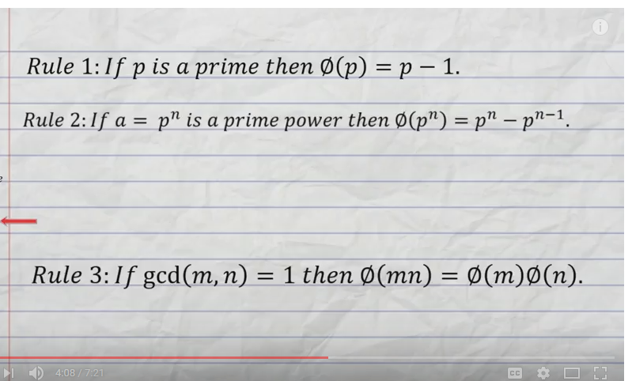

Slide 9
Rule1:
  ϕ(41) = 41-1 since 41 is a prime number
Rule 2:
  ϕ(32)=2⁵ = 2⁵ – 2⁴ =16
  32 can be written as a Power of prime number 2
Rule 3:
  ϕ(35)= 7 x 5 = (7-1) (5-1)= 24
  35 is written as product of two primes
Rule 1

Slide 10
Euler Totient Function φ(n)
The multiplicative group for Z_{n}, denoted with Z*_{n}, is the subset of elements of Z_{n} relatively prime with n.
The totient function of n, denoted with φ(n), is the size of Z*_{n}
Example Z*₁₀ = { 1, 3, 7, 9 } φ(10) = 4
{(2,10),(4,10),(5,10),(6,10),(8,10),(10,10)}
{(1,10), (3,10),(7,10),(9,10)}

Slide 11
Euler Totient Function φ(n)
If p is prime, we have Z*_{p} = {1, 2, …, (p − 1)}
φ(p) = p − 1
For each element x of Z*_{n}, we have x ^{φ(n)} mod n = 1
Example (n = 10) φ(10) = 4
3^{φ(10)} mod 10 = 3⁴ mod 10 = 81 mod 10 = 1
7^{φ(10)} mod 10 = 7⁴ mod 10 = 2401 mod 10 = 1
9^{φ(10)} mod 10 = 9⁴ mod 10 = 6561 mod 10 = 1

Slide 12
Euler Totient Function ø(n)
to compute ø(n) need to count number of elements to be excluded
in general need prime factorization, but
  for p (p prime) ø(p) = p-1
  for p.q (p,q prime) ø(p.q) = (p-1)(q-1)
eg.
  ø(37) = 36
  ø(21) = (3–1)×(7–1) = 2×6 = 12

Slide 13
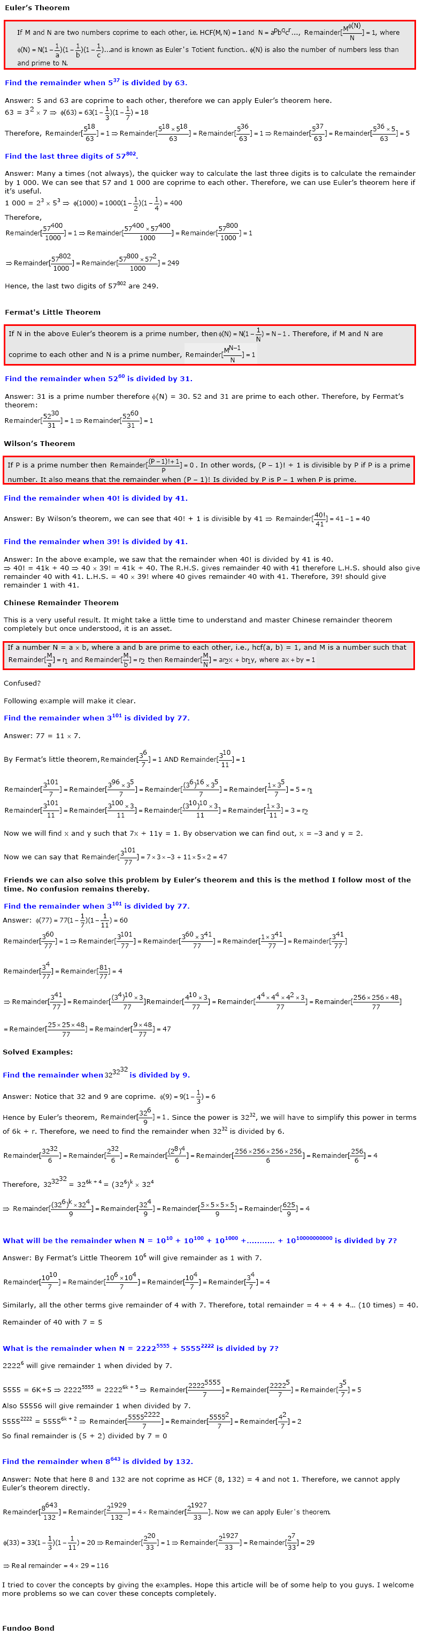

Slide 14
5

